Slide 1
A Guide to Raiseonline
Key performance measures

Slide 2
Prior Attainment Informs the Journey
KS1 Teacher Assessments
KS2 Tests
KS4 Exams
Post 16
Progress
Progress
Progress
Expectation to progress from Level 2 to Level 4
Expectation to progress form level 4 to a Grade C
A level grade is dependent on GCSE average point score

Slide 3
Prior Attainment Informs the Journey
School Data Thresholds and Floors
Combined RWM Level 4+ = 65%
Expected levels of Progress in Reading 94% Writing 96% and maths 93%
5+A*-CEM = 40%
Expected levels of Progress in English 73% and maths 68%
Key Stage 2 Test | Points: all subjects
6 | 39
5 | 33
4 | 27
3 | 21
2, N or B (Below) | 15
GCSE Grade | Grade APS Points
A* | 58
A | 52
B | 46
C | 40
D | 34
E | 28
F | 22
G | 16
HPA
MPA
LPA
HPA
MPA
LPA
Key Stage 1 Tests | Points: all subjects
4+ | 27
3 | 21
2A 2B 2C | 17 15 13
1 | 9
W – Working towards level 1 | 3
Progress
Progress
Expectation to progress from Level 2 to Level 4
Expectation to progress form level 4 to a Grade C
HIGH PRIOR ATTAINERS
MEDIUM PRIOR ATTAINERS
LOW PRIOR ATTAINERS

Slide 4
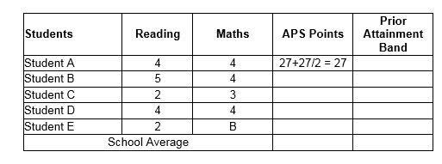
Task 1Prior Attainment

Slide 5
Task 1 Prior Attainment

Slide 6
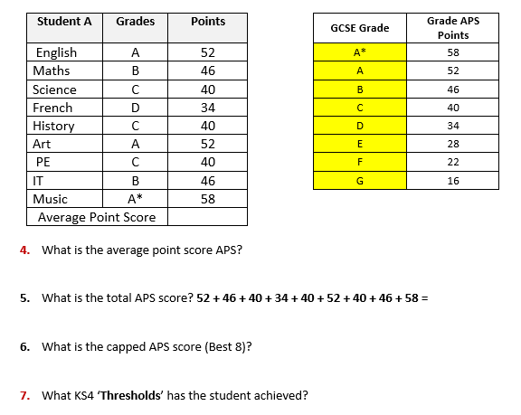
Task 2 Average Point Scores

Slide 7
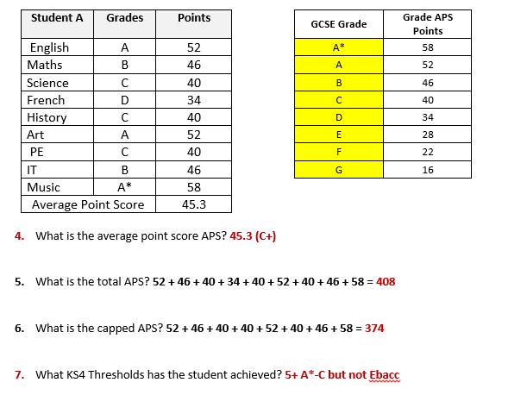
Average Point Scores

Slide 8
Task 3 -Expected Progress - Prior Attainment (input) with Outcomes (output)
Output
Input
Above expected
Expected
Below Expected

Slide 9
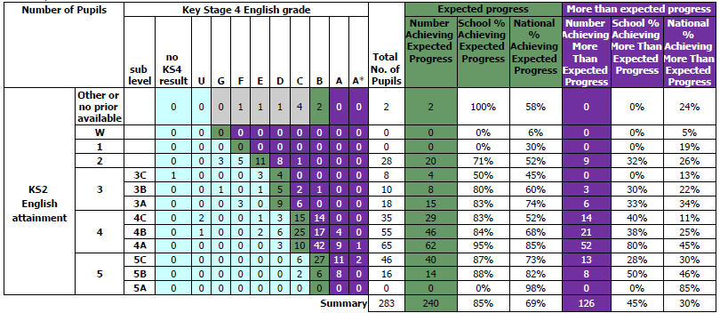
English Expected Progress

Slide 10
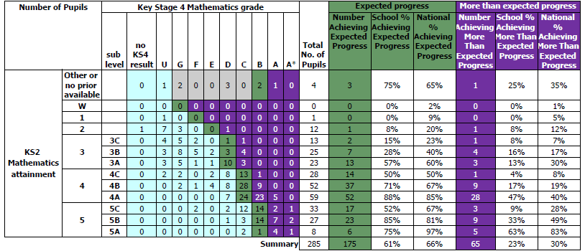
Maths Expected Progress

Slide 11
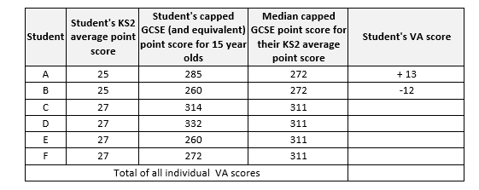
Task 4 - Value Added

Slide 12
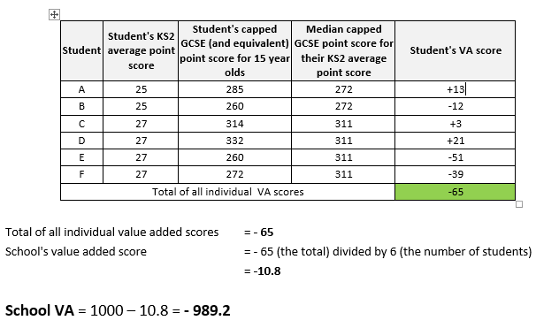
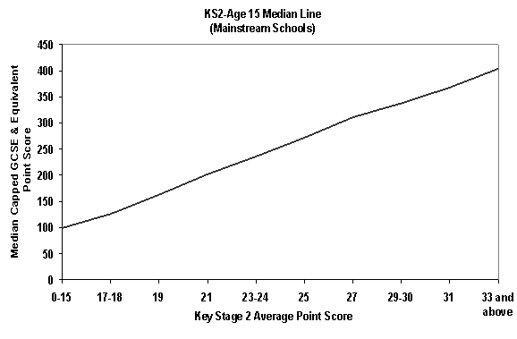
Value Added +/- 1000

Slide 13
Value Added - Primary

Slide 14
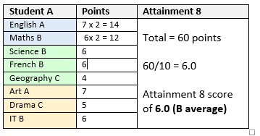
Progress 8 Student A
Student A scores 60 points
Student A KS2 Average Fine Level Prior Attainment - 4.5
Progress 8 is therefore 60 points scored – 45.8 points estimated = 14.2
This is divided by 10 to get the Progress 8 score = 14.2/10 = +1.42

Slide 15
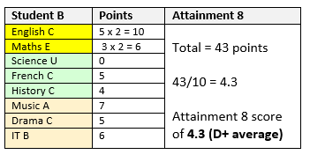
Progress 8 Student B
Student A scores 43 points
Student A KS2 Average Fine Level Prior Attainment - 4.5
Progress 8 is therefore 43 points scored – 45.8 points estimated = -2.8
This is divided by 10 to get the Progress 8 score = -2.8/10 = -0.28

Slide 16
Triangulation – Raise/Ofsted/School Improvement Plans
Raiseonline/Ofsted Dashboard | Last Ofsted Report | SEF/Academy Improvement Plan | Impact
At least twice, KS4 expected progress (or more than expected progress) from starting points for disadvantaged pupils was well below other pupils nationally in mathematics. by an amount equivalent to three or more pupils. | ‘Ensure that progress leaders use the wide range of information they have about individual pupils in each year group to ensure that the small groups of disadvantaged pupils who are not making expected progress are helped to catch up’. | Outcomes: KS4 RAP focusing on exam skills, solo, HOT questions, which are being evidenced in student work. ML’s focus on WIG and P8. All students and vulnerable groups are tracked and interventions are delivered. PPG and work with HPA students takes on a weekly basis for Year 11. | PPE Y11 data shows P8 from -0.7 to -0.5, -0.3 in December and currently (March 2016) +0.1 PPG +0.03 and Non PPG +0.15 PPG students are showing improved performance data (18.4% to 31% 5+EM from Dec to March)

